Slide 1
Chapter Twenty
Oligopoly
寡头垄断

Slide 2
Structure
Non-collusive moves
  Simultaneous moves
    Quantity competition –Cournot model
    Price competition – Bertrand model
  Sequential moves
    Quantity leadership – Stakelberg model
    Price leadership
Collusion

Slide 3
Oligopoly
A monopoly is an industry consisting a single firm.
A duopoly is an industry consisting of two firms.
An oligopoly is an industry consisting of a few firms. Particularly, each firm’s own price or output decisions affect its competitors’ profits.

Slide 4
Oligopoly
How do we analyze markets in which the supplying industry is oligopolistic?
Consider the duopolistic case of two firms supplying the same product.

Slide 5
Quantity Competition
Assume that firms compete by choosing output levels.
If firm 1 produces y₁ units and firm 2 produces y₂ units then total quantity supplied is y₁ + y₂. The market price will be p(y₁+ y₂).
The firms’ total cost functions are c₁(y₁) and c₂(y₂).

Slide 6
Quantity Competition
Suppose firm 1 takes firm 2’s output level choice y₂ as given. Then firm 1 sees its profit function as
Given y₂, what output level y₁ maximizes firm 1’s profit?

Slide 7
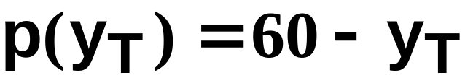
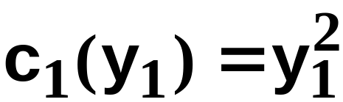
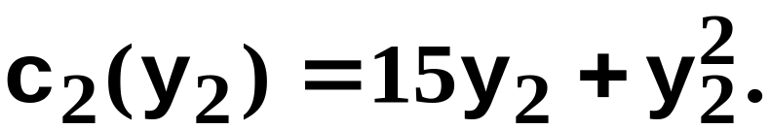
Quantity Competition; An Example
Suppose that the market inverse demand function is
and that the firms’ total cost functions are
and

Slide 8
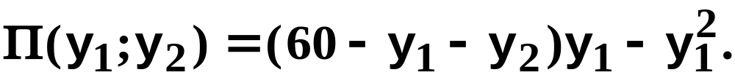
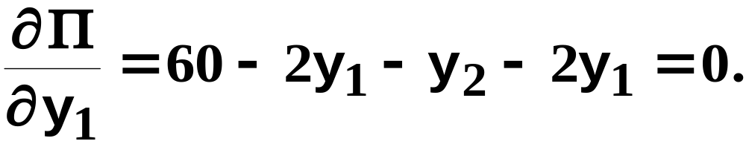
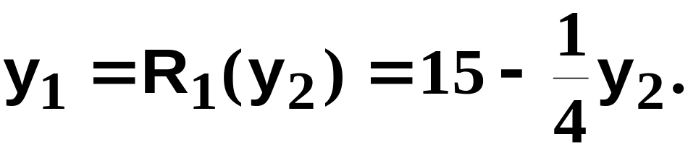
Quantity Competition; An Example
Then, for given y₂, firm 1’s profit function is
So, given y₂, firm 1’s profit-maximizing
output level solves
I.e. firm 1’s best response to y₂ is

Slide 9
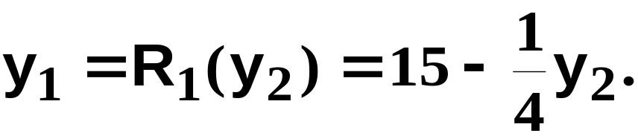
Quantity Competition; An Example
y₂
Firm 1’s “reaction curve”
60
15
y₁

Slide 10
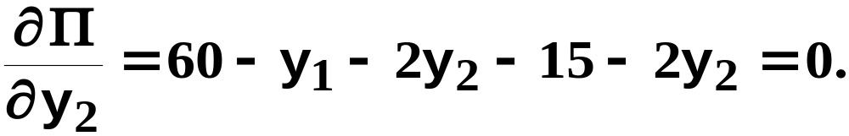
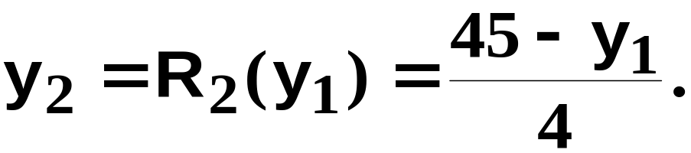
Quantity Competition; An Example
Similarly, given y₁, firm 2’s profit function is
So, given y₁, firm 2’s profit-maximizing
output level solves
I.e. firm 1’s best response to y₂ is

Slide 11
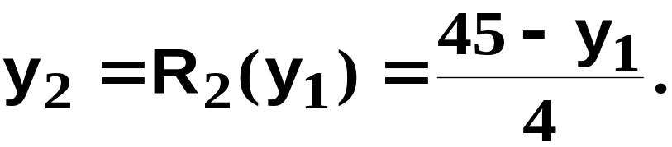
Quantity Competition; An Example
y₂
Firm 2’s “reaction curve”
45/4
45
y₁

Slide 12
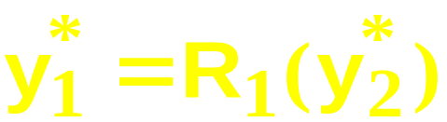
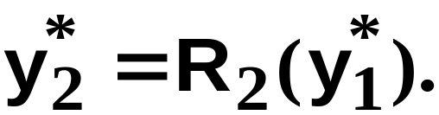
Quantity Competition; An Example
An equilibrium is when each firm’s output level is a best response to the other firm’s output level, for then neither wants to deviate from its output level.
A pair of output levels (y₁*,y₂*) is a Cournot-Nash equilibrium (古诺-纳什均衡) if
and

Slide 13
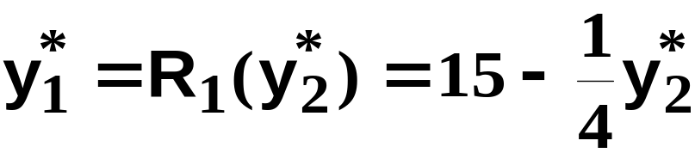
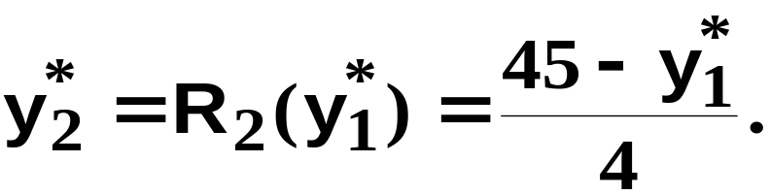
Quantity Competition; An Example
and

Slide 14
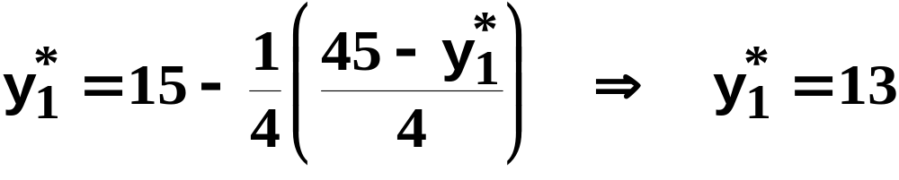
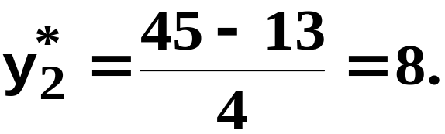
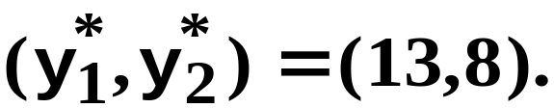
Quantity Competition; An Example
and
Substitute for y₂* to get
Hence
So the Cournot-Nash equilibrium is

Slide 15
Quantity Competition; An Example
y₂
Firm 1’s “reaction curve”
60
Firm 2’s “reaction curve”
45/4
15
45
y₁

Slide 16
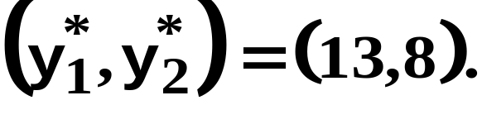
Quantity Competition; An Example
y₂
Firm 1’s “reaction curve”
60
Firm 2’s “reaction curve”
Cournot-Nash equilibrium
8
13
48
y₁

Slide 17
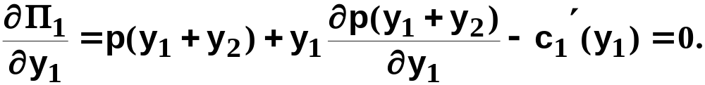
Quantity Competition
Generally, given firm 2’s chosen output
level y₂, firm 1’s profit function is
and the profit-maximizing value of y₁ solves
The solution, y₁ = R₁(y₂), is firm 1’s Cournot-
Nash reaction to y₂.

Slide 18
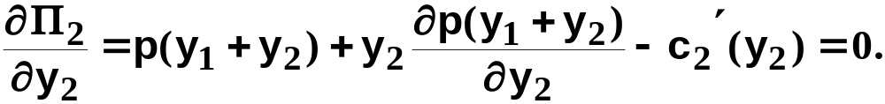
Quantity Competition
Similarly, given firm 1’s chosen output
level y₁, firm 2’s profit function is
and the profit-maximizing value of y₂ solves
The solution, y₂ = R₂(y₁), is firm 2’s Cournot-
Nash reaction to y₁.

Slide 19




Quantity Competition
y₂
Firm 1’s “reaction curve”
Firm 1’s “reaction curve”
Cournot-Nash equilibrium
y₁* = R₁(y₂*) and y₂* = R₂(y₁*)
y₁

Slide 20
Iso-Profit Curves
For firm 1, an iso-profit curve contains all the output pairs (y₁,y₂) giving firm 1 the same profit level Π₁.
What do iso-profit curves look like?

Slide 21

Iso-Profit Curves for Firm 1
y₂
With y₁ fixed, firm 1’s profit
increases as y₂ decreases.
y₁

Slide 22
Iso-Profit Curves for Firm 1
y₂
Increasing profit
for firm 1.
y₁

Slide 23
Iso-Profit Curves for Firm 1
y₂
Q: Firm 2 chooses y₂ = y₂’.
Where along the line y₂ = y₂’
is the output level that
maximizes firm 1’s profit?
y₂’
y₁

Slide 24
Iso-Profit Curves for Firm 1
y₂
Q: Firm 2 chooses y₂ = y₂’.
Where along the line y₂ = y₂’
is the output level that
maximizes firm 1’s profit?
A: The point attaining the
highest iso-profit curve for
firm 1.
y₂’
y₁’
y₁

Slide 25
Iso-Profit Curves for Firm 1
y₂
Q: Firm 2 chooses y₂ = y₂’.
Where along the line y₂ = y₂’
is the output level that
maximizes firm 1’s profit?
A: The point attaining the
highest iso-profit curve for
firm 1. y₁’ is firm 1’s
best response to y₂ = y₂’.
y₂’
y₁’
y₁

Slide 26
Iso-Profit Curves for Firm 1
y₂
Q: Firm 2 chooses y₂ = y₂’.
Where along the line y₂ = y₂’
is the output level that
maximizes firm 1’s profit?
A: The point attaining the
highest iso-profit curve for
firm 1. y₁’ is firm 1’s
best response to y₂ = y₂’.
y₂’
R₁(y₂’)
y₁

Slide 27
Iso-Profit Curves for Firm 1
y₂
y₂”
y₂’
R₁(y₂”)
R₁(y₂’)
y₁

Slide 28
Iso-Profit Curves for Firm 1
y₂
Firm 1’s reaction curve
passes through the “tops”
of firm 1’s iso-profit
curves.
y₂”
y₂’
R₁(y₂’)
y₁
R₁(y₂”)

Slide 29

Iso-Profit Curves for Firm 2
y₂
Increasing profit
for firm 2.
y₁

Slide 30
Iso-Profit Curves for Firm 2
y₂
Firm 2’s reaction curve
passes through the “tops”
of firm 2’s iso-profit
curves.
y₂ = R₂(y₁)
y₁

Slide 31
Collusion （共谋）
Q: Are the Cournot-Nash equilibrium profits the largest that the firms can earn in total?

Slide 32
Collusion
y₂
(y₁*,y₂*) is the Cournot-Nash
equilibrium.
Are there other output level
pairs (y₁,y₂) that give
higher profits to both firms?
y₂*
y₁*
y₁

Slide 33
Collusion
y₂
(y₁*,y₂*) is the Cournot-Nash
equilibrium.
Are there other output level
pairs (y₁,y₂) that give
higher profits to both firms?
y₂*
y₁*
y₁

Slide 34
Collusion
y₂
(y₁*,y₂*) is the Cournot-Nash
equilibrium.
Are there other output level
pairs (y₁,y₂) that give
higher profits to both firms?
y₂*
y₁*
y₁

Slide 35
Collusion
y₂
(y₁*,y₂*) is the Cournot-Nash
equilibrium.
Higher Π₂
Higher Π₁
y₂*
y₁*
y₁

Slide 36
Collusion
y₂
Higher Π₂
y₂*
Higher Π₁
y₂’
y₁’
y₁*
y₁

Slide 37
Collusion
y₂
Higher Π₂
y₂*
y₂’
Higher Π₁
y₁*
y₁
y₁’

Slide 38
Collusion
y₂
(y₁’,y₂’) earns
higher profits for
both firms than
does (y₁*,y₂*).
Higher Π₂
y₂*
y₂’
Higher Π₁
y₁*
y₁
y₁’

Slide 39
Collusion
So there are profit incentives for both firms to “cooperate” by lowering their output levels.
This is collusion.
Firms that collude are said to have formed a cartel （卡特尔）.
If firms form a cartel, how should they do it?

Slide 40
Collusion
Suppose the two firms want to maximize their total profit and divide it between them. Their goal is to choose cooperatively output levels y₁ and y₂ that maximize

Slide 41
Collusion
The firms cannot do worse by colluding since they can cooperatively choose their Cournot-Nash equilibrium output levels and so earn their Cournot-Nash equilibrium profits. So collusion must provide profits at least as large as their Cournot-Nash equilibrium profits.

Slide 42
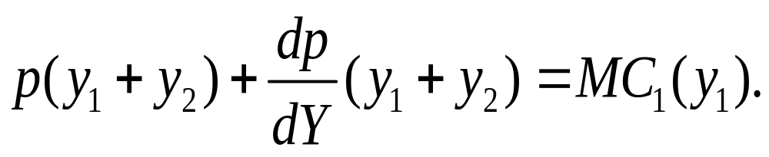
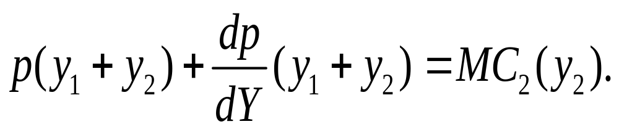
Allocate Output in a Cartel
FOC of the maximization problem:
Which implies that MC₁(y₁)=MC₂(y₂)

Slide 43
Collusion
y₂
(y₁’,y₂’) earns
higher profits for
both firms than
does (y₁*,y₂*).
Higher Π₂
y₂*
y₂’
Higher Π₁
y₁*
y₁
y₁’

Slide 44
Collusion
y₂
(y₁’,y₂’) earns
higher profits for
both firms than
does (y₁*,y₂*).
Higher Π₂
y₂*
y₂’
Higher Π₁
y₂”
(y₁”,y₂”) earns still
higher profits for
both firms.
y₁”
y₁*
y₁
y₁’

Slide 45
Collusion
y₂
~
~
(y₁,y₂) maximizes firm 1’s profit
while leaving firm 2’s profit at
the Cournot-Nash equilibrium
level.
y₂*
~
y₂
y₁*
y₁
~
y₁

Slide 46
Collusion
y₂
~
~
(y₁,y₂) maximizes firm 1’s profit
while leaving firm 2’s profit at
the Cournot-Nash equilibrium
level.
_
_
_
y₂*
(y₁,y₂) maximizes firm
2’s profit while leaving
firm 1’s profit at the
Cournot-Nash
equilibrium level.
y₂
~
y₂
_
y₂
y₁*
y₁
~
y₁

Slide 47
Collusion
y₂
The path of output pairs that
maximize one firm’s profit
while giving the other firm at
least its CN equilibrium
profit.
_
y₂*
y₂
~
y₂
_
y₂
y₁*
y₁
~
y₁

Slide 48
Collusion
y₂
The path of output pairs that
maximize one firm’s profit
while giving the other firm at
least its CN equilibrium
profit. One of
these output pairs
must maximize the
cartel’s joint profit.
_
y₂*
y₂
~
y₂
_
y₂
y₁*
y₁
~
y₁

Slide 49
Collusion
y₂
(y₁^{m},y₂^{m}) denotes
the output levels
that maximize the
cartel’s total profit.
y₂*
y₂^{m}
y₁^{m}
y₁*
y₁

Slide 50
Collusion
Is such a cartel stable?
Does one firm have an incentive to cheat on the other?
I.e. if firm 1 continues to produce y₁^{m} units, is it profit-maximizing for firm 2 to continue to produce y₂^{m} units?

Slide 51
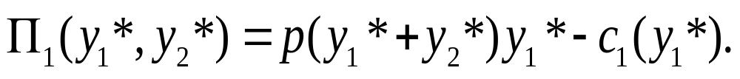
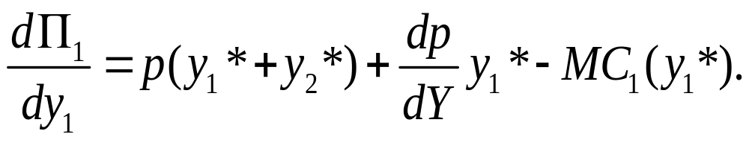
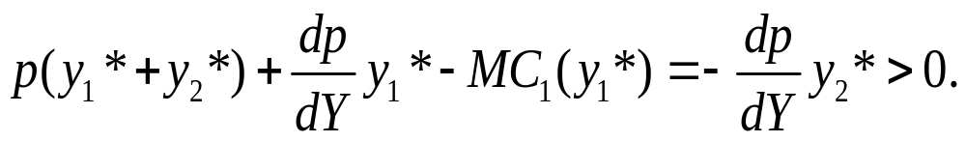
Cheating in a Cartel
At collusive output levels, firm 1’s profit is:
What happens if raising own output?
From Cartel’s FOC we know that

Slide 52
Collusion
y₂
y₁ = R₁(y₂), firm 1’s reaction curve
y₂ = R₂(y₁^{m}) is firm 2’s
best response to firm
1 choosing y₁ = y₁^{m}.
y₂^{m}
y₂ = R₂(y₁), firm 2’s
reaction curve
y₁^{m}
R₁(y₂^{m})
y₁

Slide 53
Collusion
Firm 1’s profit increases if it cheats on firm 2 by increasing its output level from y₁^{m} to R₁(y₂^{m}).

Slide 54
Collusion
y₂
y₁ = R₁(y₂), firm 1’s reaction curve
y₂ = R₂(y₁^{m}) is firm 2’s
best response to firm
1 choosing y₁ = y₁^{m}.
R₂(y₁^{m})
y₂^{m}
y₂ = R₂(y₁), firm 2’s
reaction curve
y₁^{m}
y₁

Slide 55
Collusion
Firm 2’s profit-maximizing response to y₁ = y₁^{m} is y₂ = R₂(y₁^{m}) > y₂^{m}.
Firm 2’s profit increases if it cheats on firm 1 by increasing its output level from y₂^{m} to R₂(y₁^{m}).

Slide 56
Collusion
So a profit-seeking cartel in which firms cooperatively set their output levels is fundamentally unstable.
E.g. OPEC’s broken agreements.

Slide 57
Policing a Cartel
Cooperation raises everybody’s profits.
Punishment strategies

Slide 58
The Order of Play
So far it has been assumed that firms choose their output levels simultaneously.
The competition between the firms is then a simultaneous play game in which the output levels are the strategic variables.

Slide 59
The Order of Play
What if firm 1 chooses its output level first and then firm 2 responds to this choice?
Firm 1 is then a leader. Firm 2 is a follower.
The competition is a sequential game （有序游戏）in which the output levels are the strategic variables.

Slide 60
The Order of Play
Such games are von Stackelberg games.
Is it better to be the leader?
Or is it better to be the follower?

Slide 61
Stackelberg Games
Q: What is the best response that follower firm 2 can make to the choice y₁ already made by the leader, firm 1?
A: Choose y₂ = R₂(y₁).
Firm 1 knows this and so perfectly anticipates firm 2’s reaction to any y₁ chosen by firm 1.

Slide 62
Stackelberg Games
This makes the leader’s profit function
The leader chooses y₁ to maximize its profit.
Q: Will the leader make a profit at least as large as its Cournot-Nash equilibrium profit?

Slide 63
Stackelberg Games
A: Yes. The leader could choose its Cournot-Nash output level, knowing that the follower would then also choose its C-N output level. The leader’s profit would then be its C-N profit. But the leader does not have to do this, so its profit must be at least as large as its C-N profit.

Slide 64
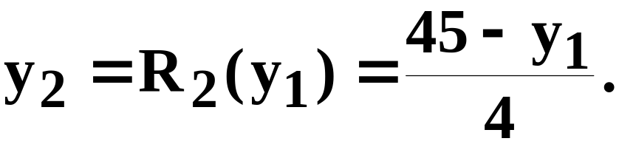
Stackelberg Games; An Example
The market inverse demand function is p = 60 - y_{T}. The firms’ cost functions are c₁(y₁) = y₁² and c₂(y₂) = 15y₂ + y₂².
Firm 2 is the follower. Its reaction function is

Slide 65
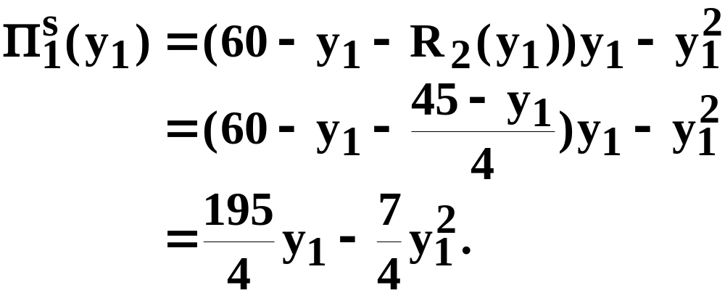
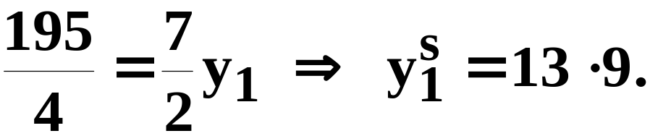
Stackelberg Games; An Example
The leader’s profit function is therefore
For a profit-maximum,

Slide 66
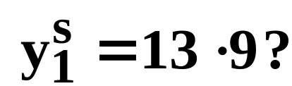
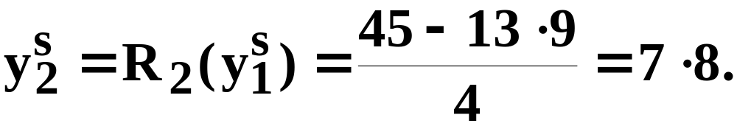
Stackelberg Games; An Example
Q: What is firm 2’s response to the
leader’s choice
A:
The C-N output levels are (y₁*,y₂*) = (13,8)
so the leader produces more than its
C-N output and the follower produces less
than its C-N output. This is true generally.

Slide 67
Stackelberg Games
y₂
(y₁*,y₂*) is the Cournot-Nash
equilibrium.
Higher Π₂
Higher Π₁
y₂*
y₁*
y₁

Slide 68
Stackelberg Games
y₂
(y₁*,y₂*) is the Cournot-Nash
equilibrium.
Follower’s
reaction curve
Higher Π₁
y₂*
y₁*
y₁

Slide 69
Stackelberg Games
y₂
(y₁*,y₂*) is the Cournot-Nash
equilibrium. (y₁^{S},y₂^{S}) is the
Stackelberg equilibrium.
Follower’s
reaction curve
y₂*
Higher Π₁
y₂^{S}
y₁*
y₁^{S}
y₁

Slide 70
Stackelberg Games
y₂
(y₁*,y₂*) is the Cournot-Nash
equilibrium. (y₁^{S},y₂^{S}) is the
Stackelberg equilibrium.
Follower’s
reaction curve
y₂*
y₂^{S}
y₁*
y₁^{S}
y₁

Slide 71
Price Competition
What if firms compete using only price-setting strategies, instead of using only quantity-setting strategies?
Games in which firms use only price strategies and play simultaneously are Bertrand games.

Slide 72
Bertrand Games
Each firm’s marginal production cost is constant at c.
All firms simultaneously set their prices.
Q: Is there a Nash equilibrium?
A: Yes. Exactly one. All firms set their prices equal to the marginal cost c. Why?

Slide 73
Bertrand Games
Suppose one firm sets its price higher than another firm’s price.
Then the higher-priced firm would have no customers.
Hence, at an equilibrium, all firms must set the same price.

Slide 74
Bertrand Games
Suppose the common price set by all firm is higher than marginal cost c.
Then one firm can just slightly lower its price and sell to all the buyers, thereby increasing its profit.
The only common price which prevents undercutting is c. Hence this is the only Nash equilibrium.

Slide 75
Sequential Price Games
What if, instead of simultaneous play in pricing strategies, one firm decides its price ahead of the others.
This is a sequential game in pricing strategies called a price-leadership game.
The firm which sets its price ahead of the other firms is the price-leader.

Slide 76
Sequential Price Games
Think of one dominant firm (the leader) and many competitive small firms (the followers).
The small firms are price-takers and so their collective supply reaction to a market price p is their aggregate supply function Y_{f}(p).

Slide 77
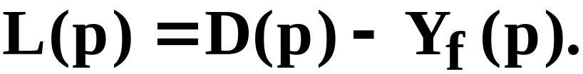
Sequential Price Games
The market demand function is D(p).
So the leader knows that if it sets a price p the quantity demanded from it will be the residual demand
Hence the leader’s profit function is

Slide 78
Sequential Price Games
The leader’s profit function is
so the leader chooses the price level p* for which profit is maximized.
The followers collectively supply Y_{f}(p*) units and the leader supplies the residual quantity D(p*) - Y_{f}(p*).

Slide 79
Sequential Price Games - Example
Demand: D(p)=a-bp
Cost:
  Leader: c₁(y₁)=cy₁
  Follower: c₂(y₂)= y₂²/2
Follower’s supply: p= y₂
Residual demand for leader:
  R(p)=D(p)-S₂(p)=a-bp-p=a-(b+1)p
Solve for a monopoly problem

Slide 80
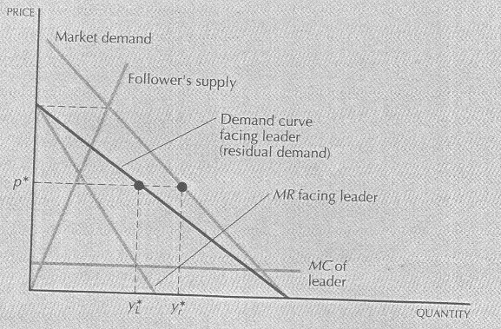
Sequential Price Games

